Slide 1
CS162 Operating Systems and Systems Programming Lecture 24 Security
April 27th, 2016
Prof. Anthony D. Joseph
http://cs162.eecs.Berkeley.edu

Slide 2



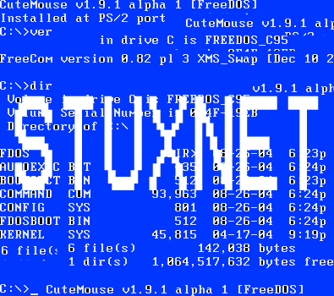



What is Computer Security Today?
Computing in the presence of an adversary!
Adversary is the security field’s defining characteristic
Reliability, robustness, and fault tolerance
Dealing with Mother Nature (random failures)
Security
Dealing with actions of a knowledgeable attacker dedicated to causing harm
Surviving malice, and not just mischance
Wherever there is an adversary, there is a computer security problem!
? ??? million
70-110 million users
.5 million
hosts
? ??? million
56 million users
BlackEnergy
SCADA malware
? ??? million
83 million users

Slide 3
Protection vs. Security
Protection: mechanisms for controlling access of programs, processes, or users to resources
Page table mechanism
Round-robin schedule
Data encryption
Security: use of protection mech. to prevent misuse of resources
Misuse defined with respect to policy
E.g.: prevent exposure of certain sensitive information
E.g.: prevent unauthorized modification/deletion of data
Need to consider external environment the system operates in
Most well-constructed system cannot protect information if user accidentally reveals password – social engineering challenge

Slide 4
Security Requirements
Authentication
Ensures that a user is who is claiming to be
Data integrity
Ensure that data is not changed from source to destination or after being written on a storage device
Confidentiality
Ensures that data is read only by authorized users
Non-repudiation
Sender/client can’t later claim didn’t send/write data
Receiver/server can’t claim didn’t receive/write data

Slide 5
Securing Communication: Cryptography
Cryptography: communication in the presence of adversaries
Studied for thousands of years
See the Simon Singh’s The Code Book for an excellent, highly readable history
Central goal: confidentiality
How to encode information so that an adversary can’t extract it, but a friend can
General premise: there is a key, possession of which allows decoding, but without which decoding is infeasible
Thus, key must be kept secret and not guessable

Slide 6
Using Symmetric Keys
Same key for encryption and decryption
Achieves confidentiality
Vulnerable to tampering and replay attacks
Plaintext (m)
m
Internet
Encrypt with
secret key
Decrypt with
secret key
Ciphertext

Slide 7
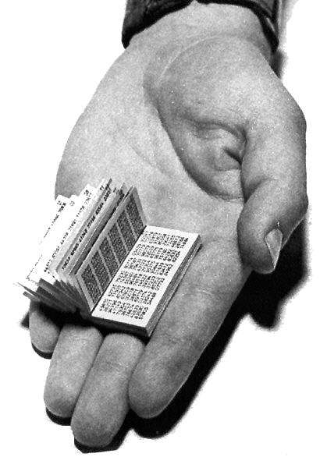
Symmetric Keys
Can just XOR plaintext with the key
Easy to implement, but easy to break using frequency analysis
Unbreakable alternative: XOR with one-time pad
Use a different key for each message

Slide 8
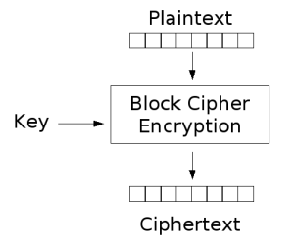
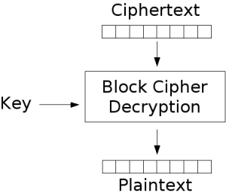
Block Ciphers with Symmetric Keys
More sophisticated (e.g., block cipher) algorithms
Works with a block size (e.g., 64 bits)
Can encrypt blocks separately:
Same plaintext⇒same ciphertext
Much better:
Add in counter and/or link ciphertext of previous block

Slide 9
Symmetric Key Ciphers - DES & AES
Data Encryption Standard (DES)
Developed by IBM in 1970s, standardized by NBS/NIST
56-bit key (decreased from 64 bits at NSA’s request)
Still fairly strong other than brute-forcing the key space
But custom hardware can crack a key in < 24 hours
Today many financial institutions use Triple DES
DES applied 3 times, with 3 keys totaling 168 bits
Advanced Encryption Standard (AES)
Replacement for DES standardized in 2002
Key size: 128, 192 or 256 bits
How fundamentally strong are they?
No one knows (no proofs exist)

Slide 10
Authentication in Distributed Systems
What if identity must be established across network?
Need way to prevent exposure of information while still proving identity to remote system
Many of the original UNIX tools sent passwords over the wire “in clear text”
E.g.: telnet, ftp, yp (yellow pages, for distributed login)
Result: Snooping programs widespread
What do we need? Cannot rely on physical security!
Encryption: Privacy, restrict receivers
Authentication: Remote Authenticity, restrict senders
Network
PASS: gina

Slide 11
Authentication via Secret Key
Main idea: entity proves identity by decrypting a secret encrypted with its own key
K – secret key shared only by A and B
A can asks B to authenticate itself by decrypting a nonce, i.e., random value, x
Avoid replay attacks (attacker impersonating client or server)
Vulnerable to man-in-the middle attack
A
B
E(x, K)
Notation: E(m,k) – encrypt message m with key k
x

Slide 12
Secure Hash Function
Hash Function: Short summary of data (message)
For instance, h₁=H(M₁) is the hash of message M₁
h₁ fixed length, despite size of message M₁
Often, h₁ is called the “digest” of M₁
Hash function H is considered secure if
It is infeasible to find M₂ with h₁=H(M₂); i.e., can’t easily find other message with same digest as given message
It is infeasible to locate two messages, m₁ and m₂, which “collide”, i.e. for which H(m₁) = H(m₂)
A small change in a message changes many bits of digest/can’t tell anything about message given its hash
Fox
Hash
Function
DFCD3454BBEA788A
751A696C24D97009
CA992D17
The red fox
runs across
the ice
Hash
Function
52ED879E70F71D92
6EB6957008E03CE4
CA6945D3

Slide 13
Integrity: Cryptographic Hashes
Basic building block for integrity: cryptographic hashing
Associate hash with byte-stream, receiver verifies match
Assures data hasn’t been modified, either accidentally – or maliciously
Approach:
Sender computes a secure digest of message m using H(x)
H(x) is a publicly known hash function
Digest d = HMAC (K, m) = H (K | H (K | m))
HMAC(K, m) is a hash-based message authentication function
Send digest d and message m to receiver
Upon receiving m and d, receiver uses shared secret key, K, to recompute HMAC(K, m) and see whether result agrees with d

Slide 14
Using Hashing for Integrity
plaintext (m)
corrupted msg
m
NO
=
digest’
Internet
Digest
HMAC(K,m)
Digest
HMAC(K,m)
Encrypted Digest
Unencrypted Message
Can encrypt m for confidentiality

Slide 15
Standard Cryptographic Hash Functions
MD5 (Message Digest version 5)
Developed in 1991 (Rivest), produces 128 bit hashes
Widely used (RFC 1321)
Broken (1996-2008): attacks that find collisions
SHA-1 (Secure Hash Algorithm)
Developed in 1995 (NSA) as MD5 successor with 160 bit hashes
Widely used (SSL/TLS, SSH, PGP, IPSEC)
Broken in 2005, government use discontinued in 2010
SHA-2 (2001)
Family of SHA-224, SHA-256, SHA-384, SHA-512 functions
HMAC’s are secure even with older “insecure” hash functions

Slide 16
Administrivia
Final Exam
Monday May 9th 3-6 PM Wheeler Auditorium
All material from the course
With slightly more focus on second half, but you are still responsible for all the material
Two double-sided sheets of handwritten notes
No calculators
Review session
May 6th 1-4 PM 390 Hearst Mining

Slide 17
break

Slide 18
Key Distribution
How do you get shared secret to both places?
For instance: how do you send authenticated, secret mail to someone who you have never met?
Must negotiate key over private channel
Exchange code book
Key cards/memory stick/others
Third Party: Authentication Server (like Kerberos)
Notation:
K_{xy} is key for talking between x and y
(…)^{K} means encrypt message (…) with the key K
Clients: A and B, Authentication server S
A asks server for key:
A→S: [Hi! I’d like a key for talking between A and B]
Not encrypted. Others can find out if A and B are talking
Server returns session key encrypted using B’s key
S→A: Message [ Use K_{ab} (This is A! Use K_{ab})^{Ksb} ] ^{Ksa}
This allows A to know, “S said use this key”
Whenever A wants to talk with B
A→B: Ticket [ This is A! Use K_{ab} ]^{Ksb}
Now, B knows that K_{ab} is sanctioned by S

Slide 19
Authentication Server Continued [Kerberos]
Key
Server
Req Ticket
Ticket
Ticket
Secure Communication
Details
Both A and B use passwords (shared with key server) to decrypt return from key servers
Add in timestamps to limit how long tickets will be used to prevent attacker from replaying messages later
Also have to include encrypted checksums (hashed version of message) to prevent malicious user from inserting things into messages/changing messages
Want to minimize # times A types in password
A→S (Give me temporary secret)
S→A (Use K_{temp-sa} for next 8 hours)^{Ksa}
Can now use K_{temp-sa} in place of K_{sa} in prototcol

Slide 20
Asymmetric Encryption (Public Key)
Idea: use two different keys, one to encrypt (e) and one to decrypt (d)
A key pair
Crucial property: knowing e does not give away d
Therefore e can be public: everyone knows it!
If Alice wants to send to Bob, she fetches Bob’s public key (say from Bob’s home page) and encrypts with it
Alice can’t decrypt what she’s sending to Bob …
… but then, neither can anyone else (except Bob)

Slide 21
Public Key / Asymmetric Encryption
Sender uses receiver’s public key
Advertised to everyone
Receiver uses complementary private key
Must be kept secret
Plaintext
Plaintext
Internet
Encrypt with
public key
Decrypt with
private key
Ciphertext

Slide 22
Public Key Encryption Details
Idea: K_{public} can be made public, keep K_{private} private
Gives message privacy (restricted receiver):
Public keys (secure destination points) can be acquired by anyone/used by anyone
Only person with private key can decrypt message
What about authentication?
Use combination of private and public key
Alice→Bob: [(I’m Alice)^{Aprivate} Rest of message]^{Bpublic}
Provides restricted sender and receiver
But: how does Alice know that it was Bob who sent her B_{public}? And vice versa…
Insecure Channel
B_{public}
B_{private}
A_{private}
A_{public}
Alice
Insecure Channel
Bob

Slide 23
Public Key Cryptography
Invented in the 1970s
Revolutionized cryptography
(Was actually invented earlier by British intelligence)
How can we construct an encryption/decryption algorithm using a key pair with the public/private properties?
Answer: Number Theory
Most fully developed approach: RSA
Rivest / Shamir / Adleman, 1977; RFC 3447
Based on modular multiplication of very large integers
Very widely used (e.g., ssh, SSL/TLS for https)
Also mature approach: Eliptic Curve Cryptography (ECC)
Based on curves in a Galois-field space
Shorter keys and signatures than RSA

Slide 24
Properties of RSA
Requires generating large, random prime numbers
Algorithms exist for quickly finding these (probabilistic!)
Requires exponentiating very large numbers
Again, fairly fast algorithms exist
Overall, much slower than symmetric key crypto
One general strategy: use public key crypto to exchange a (short) symmetric session key
Use that key then with AES or such
How difficult is recovering d, the private key?
Equivalent to finding prime factors of a large number
Many have tried - believed to be very hard (= brute force only)
(Though quantum computers could do so in polynomial time!)
Notes:
Shor’s algorithm is polynomial in log N

Slide 25
Simple Public Key Authentication
Each side need only to know the other side’s public key
No secret key need be shared
A encrypts a nonce (random num.) x
Avoid replay attacks, e.g., attacker impersonating client or server
B proves it can recover x, generates second nonce y
A can authenticate itself to B in the same way
A and B have shared private secrets on which to build private key!
We just did secure key distribution!
Many more details to make this work securely in practice!
A
B
E({x, A}, Public_{B})
E({x, y, B}, Public_{A})
E({y, A}, Public_{B})
Notation: E(m,k) – encrypt message m with key k

Slide 26
Non-Repudiation: RSA Crypto & Signatures
Suppose Alice has published public key KE
If she wishes to prove who she is, she can send a message x encrypted with her private key KD (i.e., she sends E(x, KD))
Anyone knowing Alice’s public key KE can recover x, verify that Alice must have sent the message
It provides a signature
Alice can’t deny it: non-repudiation
Could simply encrypt a hash of the data to sign a document that you wanted to be in clear text
Note that either of these signature techniques work perfectly well with any data (not just messages)
Could sign every datum in a database, for instance

Slide 27
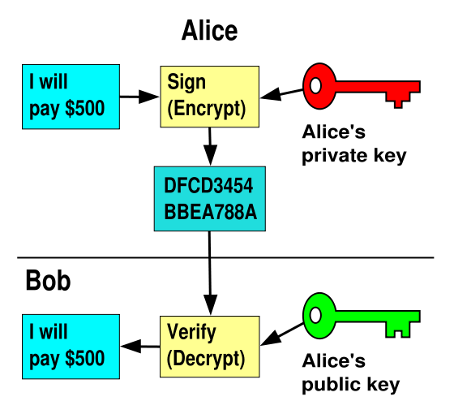
RSA Crypto & Signatures (cont’d)
I will pay Bob $500
I will pay Bob $500

Slide 28
Digital Certificates
How do you know K_{E} is Alice’s public key?
Trusted authority (e.g., Verisign) signs binding between Alice and K_{E} with its private key KV_{private}
C = E({Alice, K_{E}}, KV_{private})
C: digital certificate
Alice: distribute her digital certificate, C
Anyone: use trusted authority’s KV_{public}, to extract Alice’s public key from C
D(C, KV_{public}) = D(E({Alice, K_{E}}, KV_{private}), KV_{public}) = {Alice, K_{E}}

Slide 29
Summary of Our Crypto Toolkit
If we can securely distribute a key, then
Symmetric ciphers (e.g., AES) offer fast, presumably strong confidentiality
Public key cryptography does away with (potentially major) problem of secure key distribution
But: not as computationally efficient
Often addressed by using public key crypto to exchange a session key
Digital signature binds the public key to an entity

Slide 30
Putting It All Together - HTTPS
What happens when you click on https://www.amazon.com?
https = “Use HTTP over SSL/TLS”
SSL = Secure Socket Layer
TLS = Transport Layer Security
Successor to SSL
Provides security layer (authentication, encryption) on top of TCP
Fairly transparent to applications

Slide 31
HTTPS Connection (SSL/TLS) (cont’d)
Browser (client) connects via TCP to Amazon’s HTTPS server
Client sends over list of crypto protocols it supports
Server picks protocols to use for this session
Server sends over its certificate
(all of this is in the clear)
Browser
Amazon
Hello. I support
(TLS+RSA+AES128+SHA2) or
(SSL+RSA+3DES+MD5) or …
Let’s use
TLS+RSA+AES128+SHA2
Here’s my cert
~1 KB of data

Slide 32
Inside the Server’s Certificate
Name associated with cert (e.g., Amazon)
Amazon’s RSA public key
A bunch of auxiliary info (physical address, type of cert, expiration time)
Name of certificate’s signatory (who signed it)
A public-key signature of a hash (SHA-256) of all this
Constructed using the signatory’s private RSA key, i.e.,
Cert = E(H_{SHA256}(KA_{public}, www.amazon.com, …), KS_{private}))
KA_{public}: Amazon’s public key
KS_{private}: signatory (certificate authority) private key
…

Slide 33
Validating Amazon’s Identity
How does the browser authenticate certificate signatory?
Certificates of several certificate authorities (e.g., Verisign) are hardwired into the browser (or OS)
If can’t find cert, warn user that site has not been verified
And may ask whether to continue
Note, can still proceed, just without authentication
Browser uses public key in signatory’s cert to decrypt signature
Compares with its own SHA-256 hash of Amazon’s cert
Assuming signature matches, now have high confidence it’s indeed Amazon …
… assuming signatory is trustworthy
DigiNotar CA breach (July-Sept 2011): Google, Yahoo!, Mozilla, Tor project, Wordpress, … (531 total certificates)
Notes:
Wikipedia: DigiNotar was a Dutch certificate authority owned by VASCO Data Security International.^{[1]} On September 3, 2011, after it had become clear that a security breach had resulted in the fraudulent issuing of certificates, the Dutch government took over operational management of DigiNotar's systems.^{[2]} That same month, the company was declared bankrupt. (Wikipedia)

Slide 34
Certificate Validation
Certificate
E(H_{SHA256}(KA_{public}, www.amazon.com, …), KS_{private})),
KA_{public}, www.amazon.com, …
E(H_{SHA256}(…), KS_{public}))
(recall, KS_{public} hardwired)
H_{SHA256}(KA_{public}, www.amazon.com, ..)
H_{SHA256}(KA_{public}, www.amazon.com, …)
H_{SHA256}(KA_{public}, www.amazon.com, …)
No
=
Validation failed
Yes
Validation successful
Can also validate using peer approach: https://www.eff.org/observatory

Slide 35

HTTPS Connection (SSL/TLS) cont’d
Browser constructs a random session key K used for data communication
Private key for bulk crypto
Browser encrypts K using Amazon’s public key
Browser sends E(K, KA_{public}) to server
Browser displays
All subsequent comm. encrypted w/ symmetric cipher (e.g., AES128) using key K
E.g., client can authenticate using a password
Browser
Amazon
Here’s my cert
~1 KB of data
K
E(K, KA_{public})
Agreed
K
E(password …, K)
E(response …, K)

Slide 36
Security Summary
Many more challenges to building secure systems and applications
No fixed-point solutions
Adversaries constantly change and adapt
Defenses must also constantly change and adapt
Take CS 161

Slide 37
Thank you!
File Systems
Address Space
Concurrency
Reliability, Security
CS168 Networking
CS186 Databases
Distributed Systems
OS Concepts
intro
CS169
SW Eng
CS161
Security
CS262a
Grad OS
Let’s Thank the TAs!
Good Bye!
BerkeleyX
MOOCs

Slide 38
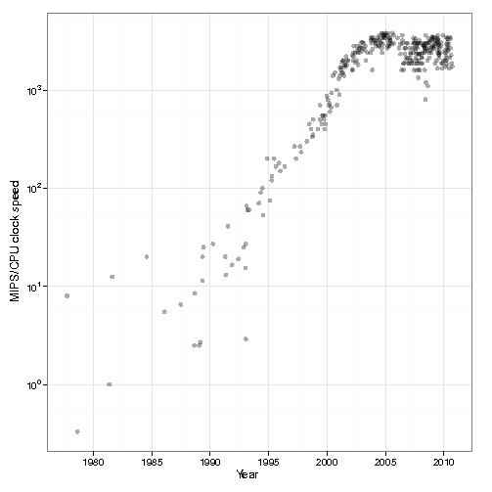
Background of Cloud Computing
1980’s and 1990’s: 52% growth in performance per year!
2002: The thermal wall
Speed (frequency) peaks, but transistors keep shrinking
2000’s: Multicore revolution
15-20 years later than predicted, we have hit the performance wall
2010’s: Rise of Big Data

Slide 39
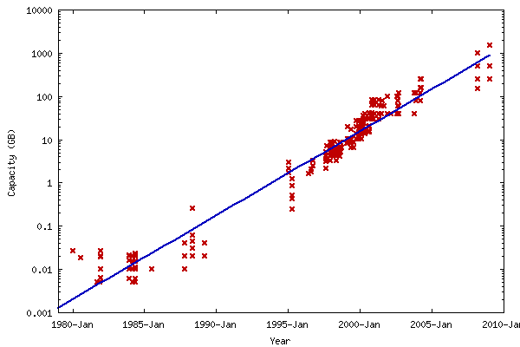
Data Deluge
Billions of users connected through the net
WWW, FB, twitter, cell phones, …
80% of the data on FB was produced last year
Storage getting cheaper
Store more data!
8TB drives common
10TB announced
Units of interest:
Gigabyte: 2³⁰ ≅ 10⁹
Terabyte: 2⁴⁰ ≅ 10¹²
Petabyte: 2⁵⁰ ≅ 10¹⁵
Exabyte: 2⁶⁰ ≅ 10¹⁸
Zettabyte: 20⁷⁰ ≅ 10²¹
Yottabyte: 20⁸⁰ ≅ 10²⁴

Slide 40


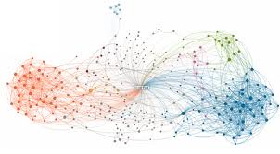
Data Grows Faster than Moore’s Law
Projected Growth
Increase over 2010

Slide 41
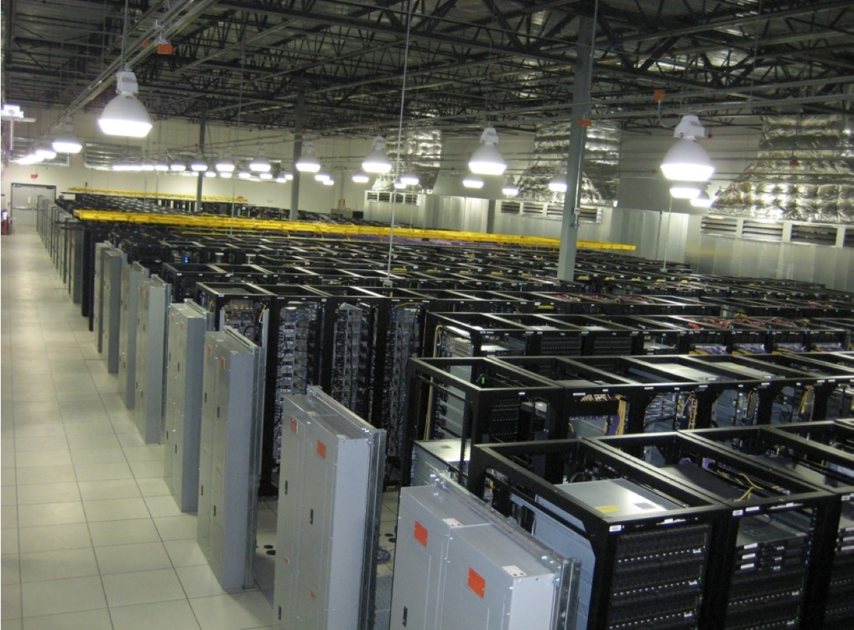
Solving the Impedance Mismatch
Computers not getting faster, and we are drowning in data
How to resolve the dilemma?
Solution adopted by web-scale companies
Go massively distributed and parallel

Slide 42
Enter the World of Distributed Systems
Distributed Systems/Computing
Loosely coupled set of computers, communicating through message passing, solving a common goal
Tools: Msg passing, Distributed shared memory, RPC
Distributed computing is challenging
Dealing with partial failures (examples?)
Dealing with asynchrony (examples?)
Dealing with scale (examples?)
Dealing with consistency (examples?)
Distributed Computing versus Parallel Computing?
distributed computing ⇒ parallel computing + partial failures
Notes:
Partial failures, network and computers
Asynchrony, network, computers,

Slide 43
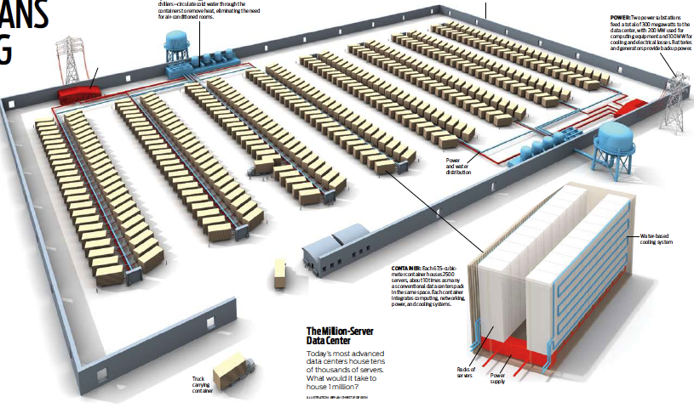

The Datacenter is the new Computer
“The datacenter as a computer” still in its infancy
Special purpose clusters, e.g., Hadoop cluster
Built from less reliable components
Highly variable performance
Complex concepts are hard to program (low-level primitives)
?
=
Notes:
During the last few years many have claimed that the datacenter is the new computer. This transformation is still in its infancy.

Slide 44
Datacenter/Cloud Computing OS
If the datacenter/cloud is the new computer
What is its Operating System?
Note that we are not talking about a host OS
Could be equivalent in benefit as the LAMP stack was to the .com boom – every startup secretly implementing the same functionality!
Open source stack for a Web 2.0 company:
Linux OS
Apache web server
MySQL, MariaDB or MongoDB DBMS
PHP, Perl, or Python languages for dynamic web pages

Slide 45
Classical Operating Systems
Data sharing
Inter-Process Communication, RPC, files, pipes, …
Programming Abstractions
Libraries (libc), system calls, …
Multiplexing of resources
Scheduling, virtual memory, file allocation/protection, …

Slide 46
Datacenter/Cloud Operating System
Data sharing
Google File System, key/value stores
Apache project: Hadoop Distributed File System
Programming Abstractions
Google MapReduce
Apache projects: Hadoop, Pig, Hive, Spark
Multiplexing of resources
Apache projects: Mesos, YARN (MapReduce v2), ZooKeeper, BookKeeper, …

Slide 47
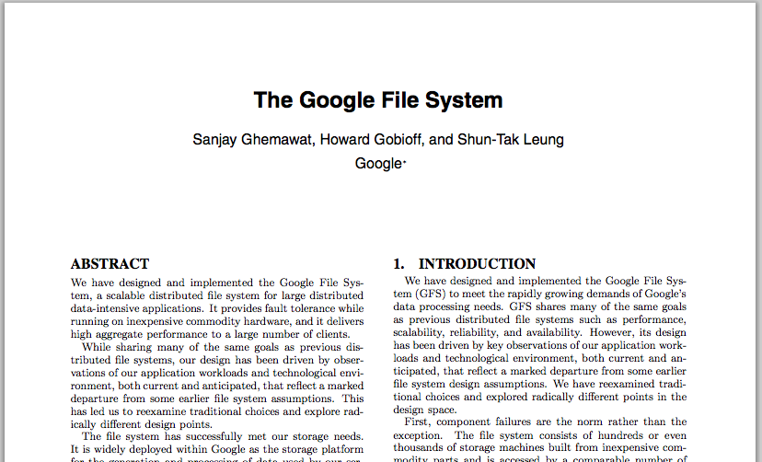
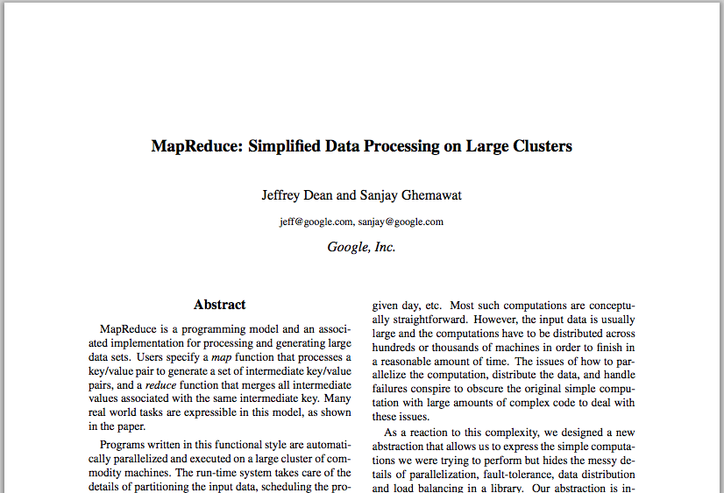
Google Cloud Infrastructure
Google File System (GFS), 2003
Distributed File System for entire cluster
Single namespace
Google MapReduce (MR), 2004
Runs queries/jobs on data
Manages work distribution & fault- tolerance
Collocated with file system
Apache open source versions: Hadoop DFS and Hadoop MR

Slide 48
GFS/HDFS Insights
Petabyte storage
Files split into large blocks (128 MB) and replicated across several nodes
Big blocks allow high throughput sequential reads/writes
Data striped on hundreds/thousands of servers
Scan 100 TB on 1 node @ 50 MB/s = 24 days
Scan on 1000-node cluster = 35 minutes
Notes:
Large block: throughput, smaller metadata to central
Stripe: would take forever to read

Slide 49
GFS/HDFS Insights (2)
Failures will be the norm
Mean time between failures for 1 node = 3 years
Mean time between failures for 1000 nodes = 1 day
Use commodity hardware
Failures are the norm anyway, buy cheaper hardware
No complicated consistency models
Single writer, append-only data
Notes:
Large block: throughput, smaller metadata to central
Stripe: would take forever to read

Slide 50
MapReduce Programming Model
Data type: key-value records
Map function:
(K_{in}, V_{in}) ➔ list(K_{inter}, V_{inter})
Reduce function:
(K_{inter}, list(V_{inter})) ➔ list(K_{out}, V_{out})

Slide 51
Word Count Execution
Input
Map
Shuffle & Sort
Reduce
Output
the, 1
brown, 1
fox, 1
the quick
brown fox
brown, 2
fox, 2
how, 1
now, 1
the, 3
Map
Reduce
the, 1
fox, 1
the, 1
the fox ate the mouse
Map
quick, 1
how, 1
now, 1
brown, 1
ate, 1
cow, 1
mouse, 1
quick, 1
ate, 1
mouse, 1
Reduce
how now
brown cow
Map
cow, 1

Slide 52
MapReduce Insights
Restricted key-value model
Same fine-grained operation (Map & Reduce) repeated on big data
Operations must be deterministic
Operations must be idempotent/no side effects
Only communication is through the shuffle
Operation (Map & Reduce) output saved (on disk)

Slide 53
What is MapReduce Used For?
At Google:
Index building for Google Search
Article clustering for Google News
Statistical machine translation
At Yahoo!:
Index building for Yahoo! Search
Spam detection for Yahoo! Mail
At Facebook:
Data mining
Ad optimization
Spam detection

Slide 54
MapReduce Pros
Distribution is completely transparent
Not a single line of distributed programming (ease, correctness)
Automatic fault-tolerance
Determinism enables running failed tasks somewhere else again
Saved intermediate data enables just re-running failed reducers
Automatic scaling
As operations as side-effect free, they can be distributed to any number of machines dynamically
Automatic load-balancing
Move tasks and speculatively execute duplicate copies of slow tasks (stragglers)
Notes:
Transparent: not a single line of code

Slide 55
MapReduce Cons
Restricted programming model
Not always natural to express problems in this model
Low-level coding necessary
Little support for iterative jobs (lots of disk access)
High-latency (batch processing)
Addressed by follow-up research and Apache projects
Pig and Hive for high-level coding
Spark for iterative and low-latency jobs
Notes:
Expressitivity; can however do graph algos, even simulate other parallel models (PRAM and BSP

Slide 56
Future?
Complete location transparency
Mobile Data, encrypted all the time
Computation anywhere any time
Cryptographic-based identities
Large Cloud-centers, Fog Computing
Internet of Things?
Everything connected, all the time!
Huge Potential
Very Exciting and Scary at same time
Better programming models need to be developed!
Perhaps talk about this on Monday

Slide 57
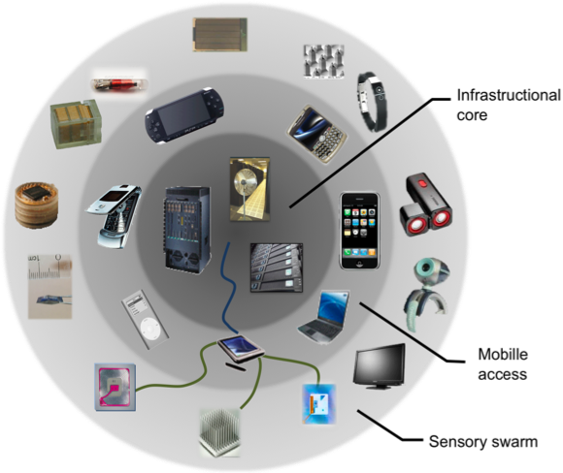

Truly Distributed Apps: The Swarm of Resources
Cloud/FOG Services
The Local Swarm:
Person, House, Office, Café
Enterprise Services

Slide 58




An New Application Model
Channel
Channel
Channel
Sensors
with Aggregation
Real-Time Components
Channel
Transform and Archive
Channel
SwarmLet (“The Application”)
Distributed
Archival Storage
A Swarm Application is a Connected graph of Components
Globally distributed, but locality and QoS aware
Avoid Stovepipe solutions through reusability
Many components are Shared Services written by programmers with a variety of skill-sets and motivations
Service Level Agreements (SLA) with micropayments
Notes:
Note: We want to make it possible for everyone to construct sophisticated swarm applications by writing small components (Swarmlets)

Slide 59
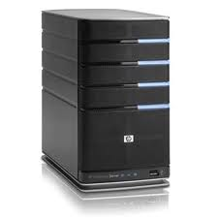
Recall: Iterative vs. Recursive Query
Master/Directory
Master/Directory
get(K14)
get(K14)
V14
K14
N3
N3
K14
N3
V14
get(K14)
get(K14)
Recursive
V14
Iterative
K14
V14
K14
V14
…
…
N1
N2
N3
N50
N1
N2
N3
N50
Recursive Query:
Advantages:
Faster, as typically master/directory closer to nodes
Easier to maintain consistency, as master/directory can serialize puts()/gets()
Disadvantages: scalability bottleneck, as all “Values” go through master/directory
Iterative Query
Advantages: more scalable
Disadvantages: slower, harder to enforce data consistency

Slide 60
Scalability
More Storage: use more nodes
More Requests:
Can serve requests from all nodes on which a value is stored in parallel
Master can replicate a popular value on more nodes
Master/directory scalability:
Replicate it
Partition it, so different keys are served by different masters/directories
How do you partition?

Slide 61
Scalability: Load Balancing
Directory keeps track of the storage availability at each node
Preferentially insert new values on nodes with more storage available
What happens when a new node is added?
Cannot insert only new values on new node. Why?
Move values from the heavy loaded nodes to the new node
What happens when a node fails?
Need to replicate values from fail node to other nodes

Slide 62
Consistency
Need to make sure that a value is replicated correctly
How do you know a value has been replicated on every node?
Wait for acknowledgements from every node
What happens if a node fails during replication?
Pick another node and try again
What happens if a node is slow?
Slow down the entire put()? Pick another node?
In general, with multiple replicas
Slow puts and fast gets

Slide 63
Consistency (cont’d)
If concurrent updates (i.e., puts to same key) may need to make sure that updates happen in the same order
put(K14, V14’) and put(K14, V14’’) reach N1 and N3 in reverse order
What does get(K14) return?
Undefined!
Master/Directory
put(K14, V14’)
K5
N2
put(K14, V14’’)
K14
N1,N3
K105
N50
put(K14, V14’’)
put(K14, V14’)
put(K14, V14’')
put(K14, V14’)
K14
K14
V14
V14’
K5
V5
K14
K14
V14
V14’’
K105
V105
…
N₁
N₂
N₃
N₅₀

Slide 64
Consistency (cont’d)
Large variety of consistency models:
Atomic consistency (linearizability): reads/writes (gets/puts) to replicas appear as if there was a single underlying replica (single system image)
Think “one updated at a time”
Transactions
Eventual consistency: given enough time all updates will propagate through the system
One of the weakest form of consistency; used by many systems in practice
Must eventually converge on single value/key (coherence)
And many others: causal consistency, sequential consistency, strong consistency, …

Slide 65
Quorum Consensus
Improve put() and get() operation performance
Define a replica set of size N
put() waits for acknowledgements from at least W replicas
get() waits for responses from at least R replicas
W+R > N
Why does it work?
There is at least one node that contains the update
Why might you use W+R > N+1?

Slide 66
Quorum Consensus Example
N=3, W=2, R=2
Replica set for K14: {N1, N2, N4}
Assume put() on N3 fails
put(K14, V14)
ACK
put(K14, V14)
put(K14, V14)
ACK
K14
V14
K14
V14
N₁
N₂
N₃
N₄

Slide 67
Quorum Consensus Example
Now, issuing get() to any two nodes out of three will return the answer
get(K14)
get(K14)
V14
nill
K14
V14
K14
V14
N₁
N₂
N₃
N₄

Slide 68
Scaling Up Directory
Challenge:
Directory contains a number of entries equal to number of (key, value) tuples in the system
Can be tens or hundreds of billions of entries in the system!
Solution: consistent hashing
Associate to each node a unique id in an uni-dimensional space 0..2^{m}-1
Partition this space across m machines
Assume keys are in same uni-dimensional space
Each (Key, Value) is stored at the node with the smallest ID larger than Key

Slide 69
Key to Node Mapping Example
m = 6 → ID space: 0..63
Node 8 maps keys [5,8]
Node 15 maps keys [9,15]
Node 20 maps keys [16, 20]
…
Node 4 maps keys [59, 4]
63
0
4
58
8
14
V14
15
44
20
35
32

Slide 70
Lookup in Chord-like system (with Leaf Set)
Assign IDs to nodes
Map hash values to node with closest ID
Leaf set is successors and predecessors
All that’s needed for correctness
Routing table matches successively longer prefixes
Allows efficient lookups
Data Replication:
On leaf set
Source
111…
0…
110…
Response
10…
Lookup ID
Notes:
Each node is assigned an ID randomly
IDs are arranged into a ring by numerical order, top ID wraps around to 0
Each node maintains two sets of neighbors, its leaf set and routing table
Leaf set is immediate predecessor and successor
Routing table neighbors resolve successively longer matching prefixes of node’s own ID
Lookup queries are routed greedily to node with closest matching ID (numerically, not lexigraphically)
Response is sent directly to querying node
Lookup handled differently in other DHTs; see Gummadi et al.’s SIGCOMM paper for details

Slide 71
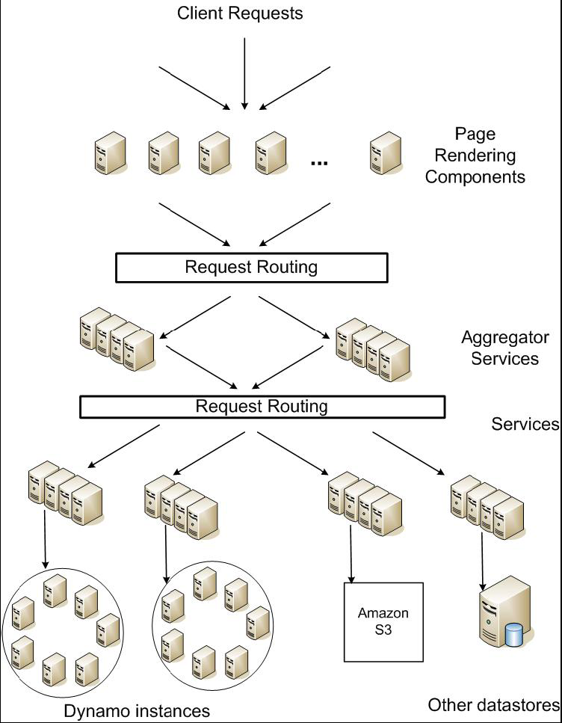
DynamoDB Example: Service Level Agreements (SLA)
Application can deliver its functionality in a bounded time:
Every dependency in the platform needs to deliver its functionality with even tighter bounds.
Example: service guaranteeing that it will provide a response within 300ms for 99.9% of its requests for a peak client load of 500 requests per second
Contrast to services which focus on mean response time
Service-oriented architecture of
Amazon’s platform

